Slide 1
Φ=1.618
Golden Ratio
Golden Rectangle
Fibonacci Sequence
Arithmetic Series
Chapter 1: Discovering Mathematics

Slide 2
Anatomy of a Pentagon
A circle has a diameter
A pentagon has a diagonal
A circle has a circumference and subtended arc for given angles
A pentagon has a circumference and, because it has edges, an edge length

Slide 3

Anatomy of a Pentagon
For a circle, it was interesting to consider the ratio of the circumference to the diameter.
For a pentagon, consider the ratio of the length of a diagonal to the length of an edge.
The ratio will always be greater than 1.
Let’s make the edge size 1 to make the numbers easy. Then, the ratio is just the diagonal.
$$Ratio=\frac{Diagonal}{Edge}$$

Slide 4
Anatomy of a Pentagon
Isosceles Triangle

Slide 5
Anatomy of a Pentagon
Exterior Angle
The exterior angle ACD of the triangle ABC is equal to the sum of the opposite two angles in the triangle

Slide 6
Anatomy of a Pentagon

Slide 7
Anatomy of a Pentagon
Why is this β?

Slide 8
Anatomy of a Pentagon

Slide 9
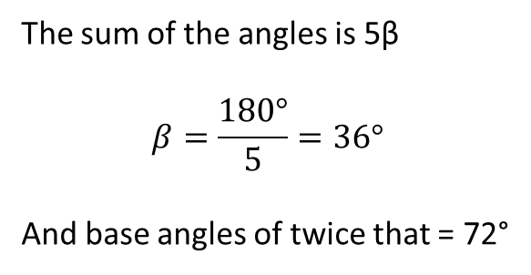
Find φ
φ-1
The sum of the angles is 5β
$$β=\frac{180°}{5}=36°$$
And base angles of twice that = 72°
Golden Triangle

Slide 10

Find φ
Golden Triangle
φ-1

Slide 11
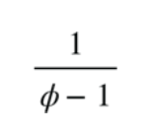
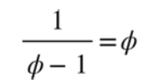
Golden Triangles
Recall…
So…

Slide 12
Golden Rectangle
Start with a Square

Slide 13
Golden Rectangle
Start with a Square

Slide 14
Golden Rectangle
What’s the ratio of the larger side to the smaller side?
A circle has diameter
A pentagon has diagonal and edge length
A rectangle has height and width
1

Slide 15
Golden Rectangle
This is also a Golden Rectangle
It goes on forever!
Prove it:
Ratio of large / small =
φ =1.618
So…

Slide 16
Fibonacci
Leonardo of Pisa
Popularized the Arabic digits 0 to 9
He was also known as Fibonacci

Slide 17
Fibonacci Sequence
F(0) = 1
F(1) = 1
F(n) = F(n-1) + F(n-2)

Slide 18
Fibonacci Sequence
F(0) = 1
F(1) = 1
F(n) = F(n-1) + F(n-2)

Slide 19
Fibonacci Sequence
F(0) = 1
F(1) = 1
F(n) = F(n-1) + F(n-2)

Slide 20



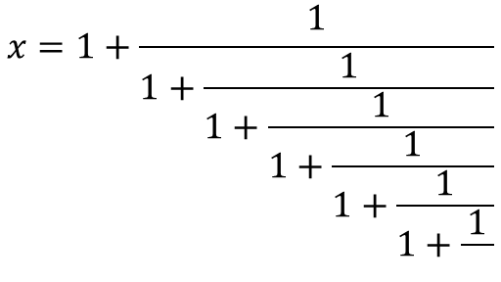
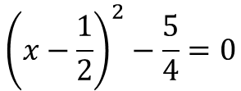


Repeated Fractions
Take this basic Repeated Fraction
$$x=1+\frac{1}{1+\frac{1}{1+\frac{1}{1+\frac{1}{1+\frac{1}{1+\frac{1}{}}}}}}$$
Can be written as…
Complete the square
$$x=1+\frac{1}{x}$$
$${\left(x−\frac{1}{2}\right)}^{2}−\frac{5}{4}=0$$
…
$$x^{2}=x+1$$
$$x−\frac{1}{2}=\frac{\sqrt{5}}{2}$$
$$x^{2}−x−1=0$$
$$x=\frac{1+\sqrt{5}}{2}=1.618$$

Slide 21

Repeated Fractions
Look at this Repeated Fraction
$$x=1+\frac{1}{1+\frac{1}{1+\frac{1}{1+\frac{1}{1+\frac{1}{1+\frac{1}{}}}}}}$$
$$x=\frac{1+\sqrt{5}}{2}=1.618$$
…

Slide 22
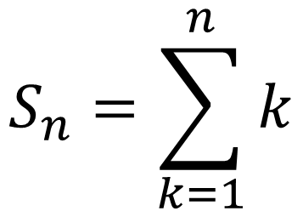
Arithmetic Series
What is the sum of the first 30 numbers, 1 through 30?
$$S_{n}=\sum_{k=1}^{n}{k}$$

Slide 23
Arithmetic Series
What is the sum of the first 30 numbers, 1 through 30?
Column A are the numbers listed, then you can add them up
Column B is a running sum

Slide 24
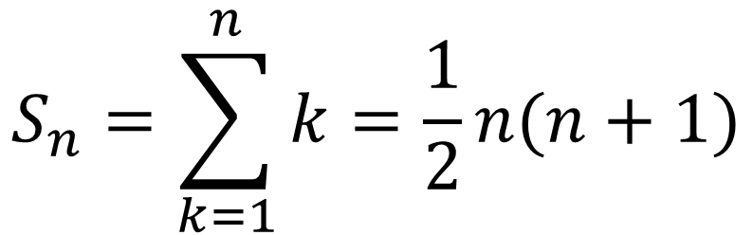
Divide and Conquer
What is the sum of the first 30 numbers, 1 through 30?
Is there any way to split this problem up?
$$S_{n}=\sum_{k=1}^{n}{k=\frac{1}{2}n(n+1)}$$

