Slide 1
Circles and Waves
Exponents and Logarithms
Slopes
Areas
and e
Chapter 1: Discovering Mathematics

Slide 2
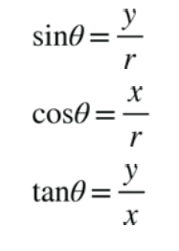

Moving around the circle – Circular Functions
A triangle within a circle
Therefore….
Pythagorean Theorem

Slide 3
What if we alter θ? What happens to the short side of the triangle?
This is the ground
(reference 0)

Slide 4
Multiplying in the 17th Century
Is there any way we can add instead of multiply?
Multiplying large numbers was a long and tedious task.
Multiplying these two expressions we get:

Slide 5
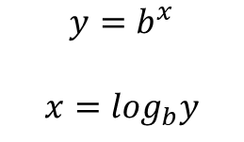
Multiplying in the 17th Century
Invent logarithms
Spent 20 years calculating log tables that he published in 1614
$$y=b^{x}$$
$$x=\log_{b}y$$

Slide 6
Multiplying in the 17th Century
Distances get closer and closer together

Slide 7
Multiplying from the 17th Century to 1960s

Slide 8




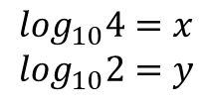
Multiplying in the 17th Century
It turns multiplication into distances that can be added:
Let’s multiply 4 * 2 without multiplying.
$${10}^{x}=4 \\ {10}^{y}=2$$
$$\log_{10}4=x \\ \log_{10}2=y$$
$$4 ∗2={10}^{x}∗{10}^{y}={10}^{x+y}$$
$$\log_{10}\left(4 ∗2\right)=x+y$$
$$\log_{10}\left(4 ∗2\right)=\log_{10}4+\log_{10}2$$

Slide 9
Multiplying from the 17th Century to 1960s
$$\log_{10}\left(4 ∗2\right)=\log_{10}4+\log_{10}2$$

Slide 10
Multiplying from the 17th Century to 1960s
Distances that can be subtracted instead of division!

Slide 11
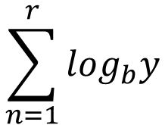
Multiplying from the 17th Century to 1960s
Turn exponentiation into multiplication (or a sum)
$$\sum_{n=1}^{r}{\log_{b}y}$$

Slide 12
Changing the Base

Slide 13
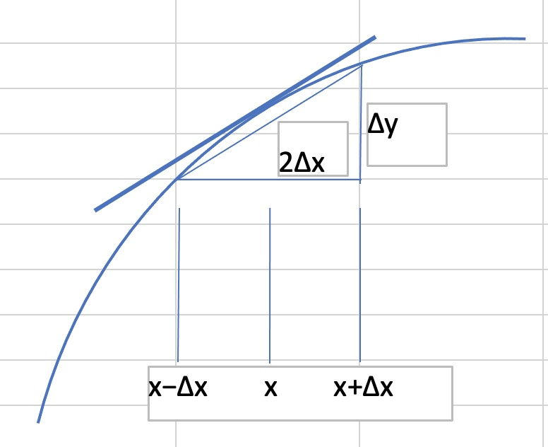

Things change: Slopes
Things change, at different rates, sometimes up and sometimes down. Let’s look at slopes of functions.

Slide 14
Slopes
Let’s take the average:

Slide 15
Slopes

Slide 16
Slopes
Slope curve is higher
Slope curve is lower
Can we find a base B where the slope curve is the same?

Slide 17
Slopes
Can we find the change in y for the smallest possible ∆x?
∆x = 0?
Zeros and Infinities

Slide 18
Slopes
The derivative of f

Slide 19

Slopes
Can we find a base B where the slope curve is the same?
$$\frac{d}{dx}\left(b^{x}\right)= b^{x}$$
The derivative of f

Slide 20

Slopes
$$\frac{d}{dx}\left(b^{x}\right)= b^{x}$$
Can we find a base B where the slope curve is the same?
Let’s get rid of the limit for now…

Slide 21

Slopes
$$\frac{d}{dx}\left(b^{x}\right)= b^{x}$$
Can we find a base B where the slope curve is the same?
Let’s consider the limit again…

Slide 22
Slopes
$$\frac{d}{dx}\left(b^{x}\right)= b^{x}$$
Can we find a base B where the slope curve is the same?

Slide 23
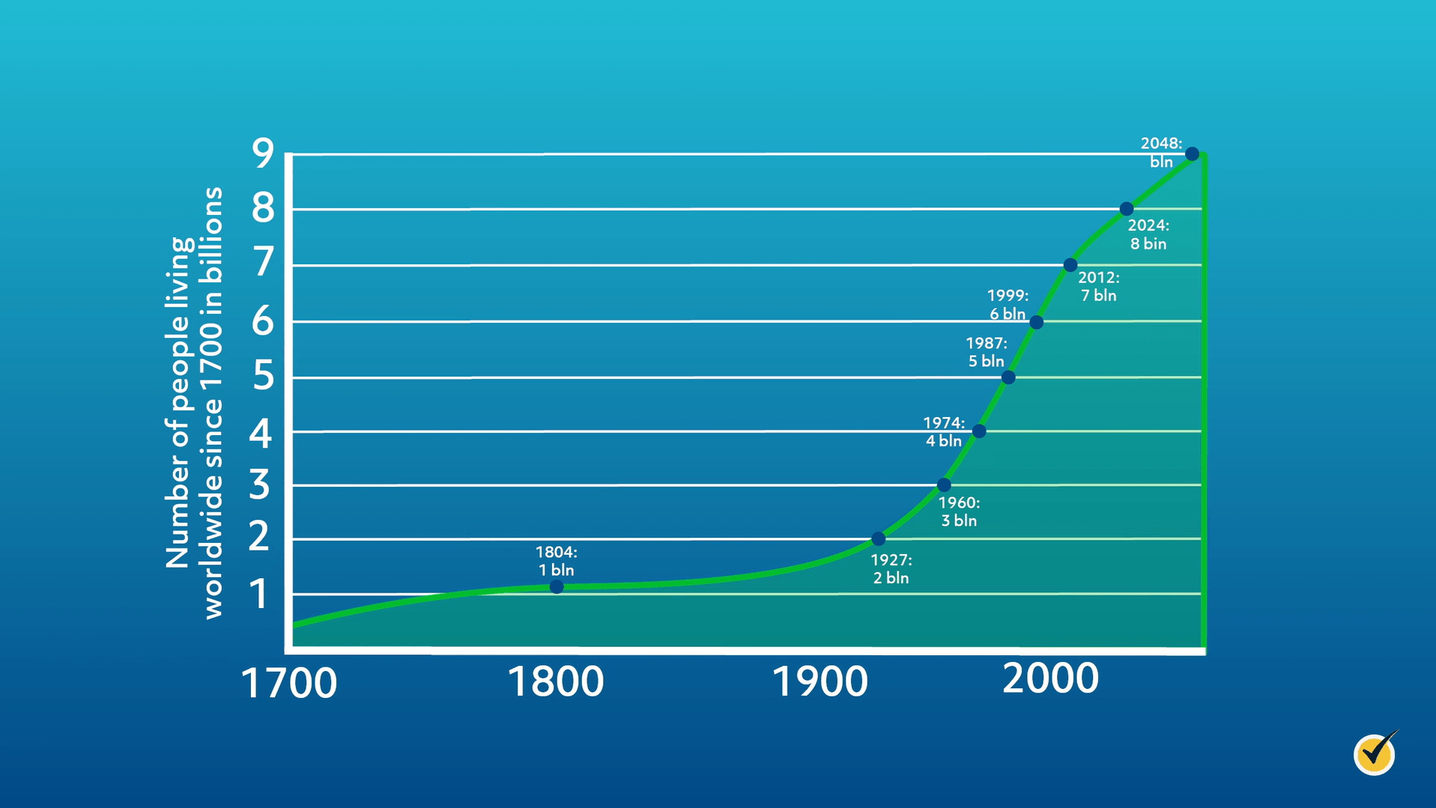

e
Population Growth, for example
$$P=P_{0}e^{rt}$$

Slide 24
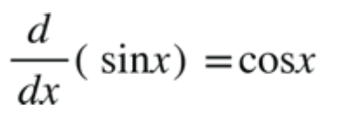
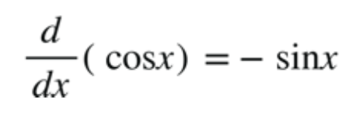
Slopes
What about something periodic like sine and cosine?

Slide 25
Slopes
Other functions

Slide 26
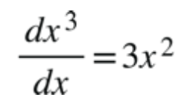

Slopes
Other functions
$$\frac{dx^{n}}{dx}=nx^{(n−1)}$$
Power down,
Power to one less

Slide 27
Accumulating the result: Area
As a function proceeds in the x-direction, the area under the curve represents an accumulation. For example, if the function is velocity in m/s, the area under the curve is distance traveled (m/s added up over s seconds)

Slide 28

Areas
$$C=2πr$$

Slide 29
Areas

Slide 30
Areas
Let’s make the radius 1

Slide 31
Areas
Sine and Cosine

Slide 32
Areas
Sine and Cosine

Slide 33
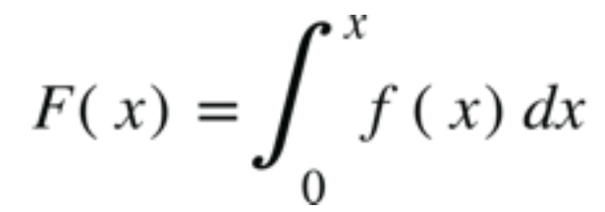
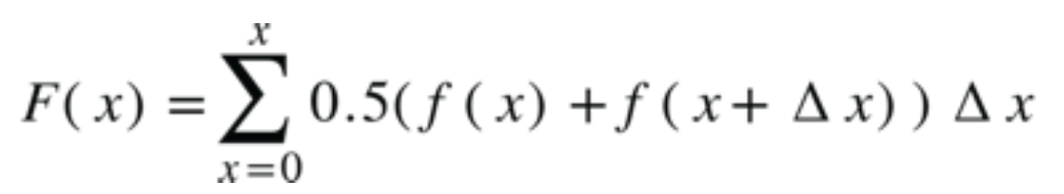
Areas
Sine and Cosine
First Fundamental Theorem of Calculus
Take the limit as ∆x → 0

Slide 34
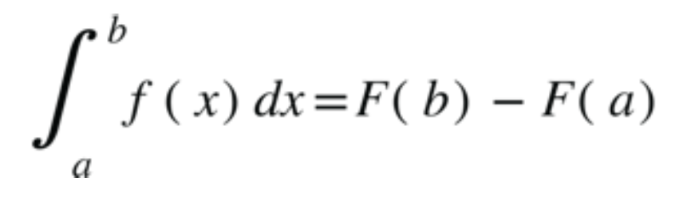
Areas
Sine and Cosine
Second Fundamental Theorem of Calculus

Slide 35
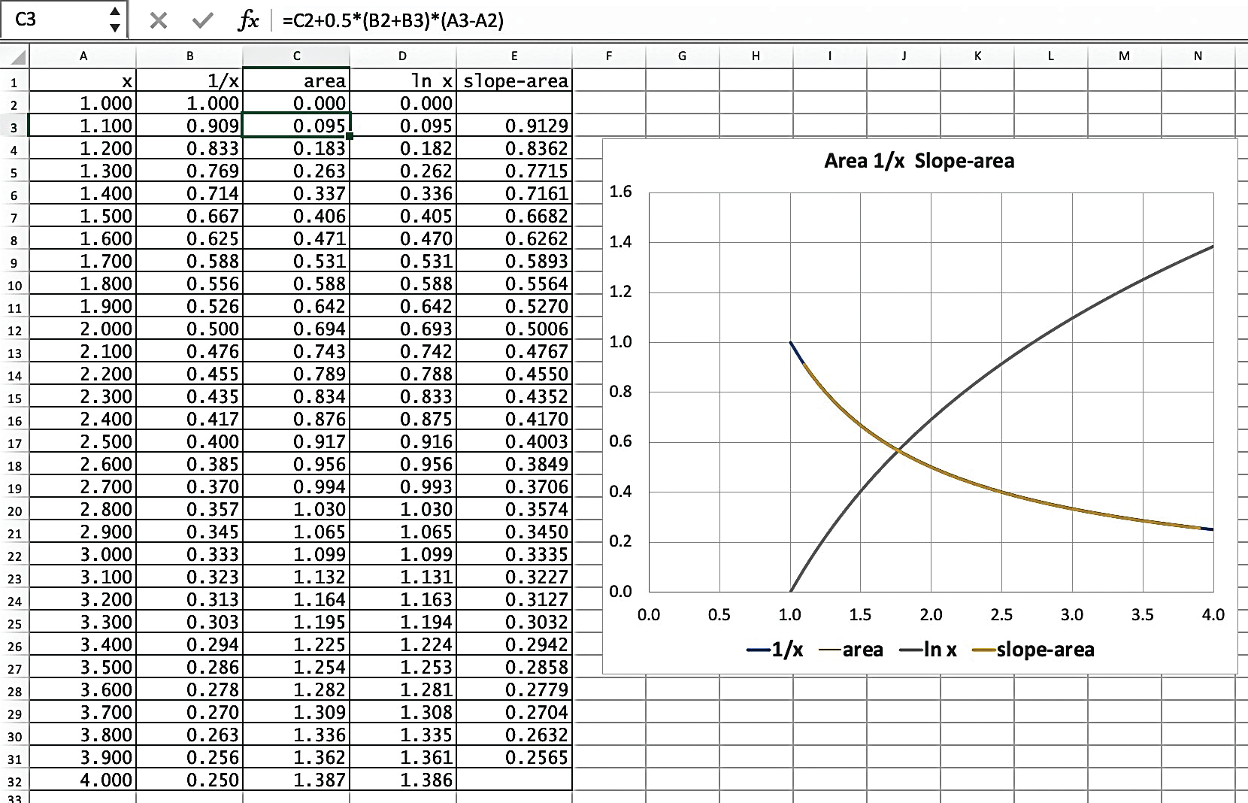
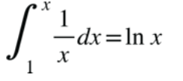
Areas of 1/x and LN x
First Fundamental Theorem of Calculus

Slide 36
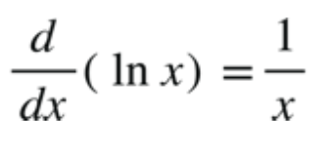
Areas of 1/x and LN x

Slide 37
Recall from before: Slope of log base e (a.k.a LN) is 1/x

Slide 38


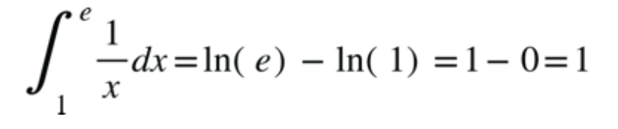
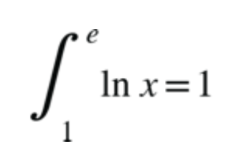
Areas of 1/x and LN x
and

Slide 39
Remember how we found e?
Slope curve is higher
Slope curve is lower
Can we find a base B where the slope curve is the same?

Slide 40
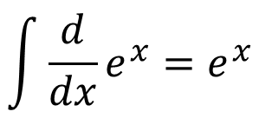
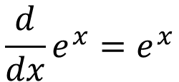
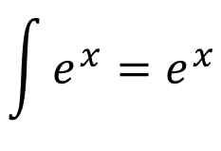
Remember how we found e?
$$\frac{d}{dx}e^{x}=e^{x}$$
B=e is the base for which B^{x} is the slope curve of itself and, therefore, the area of itself, as well
$$\int{\frac{d}{dx}e^{x}}=e^{x}$$
$$\int{e^{x}}=e^{x}$$

